Slide 1
Bakers Union and FELRA
Health and Welfare fund
Plan Review
January – March 2018
June 18, 2018
Presenters:
Holly Agoney: Account Executive

Slide 2
Key Performance
Indicators

Slide 3
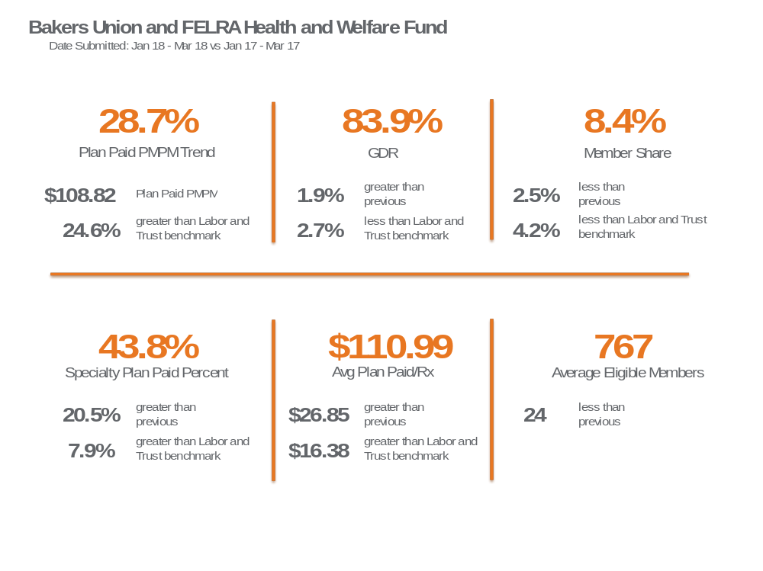

Slide 4
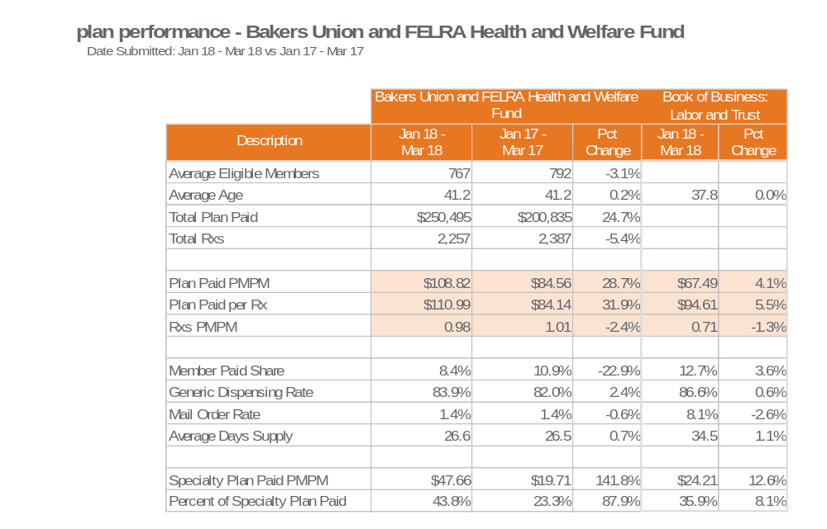

Slide 5
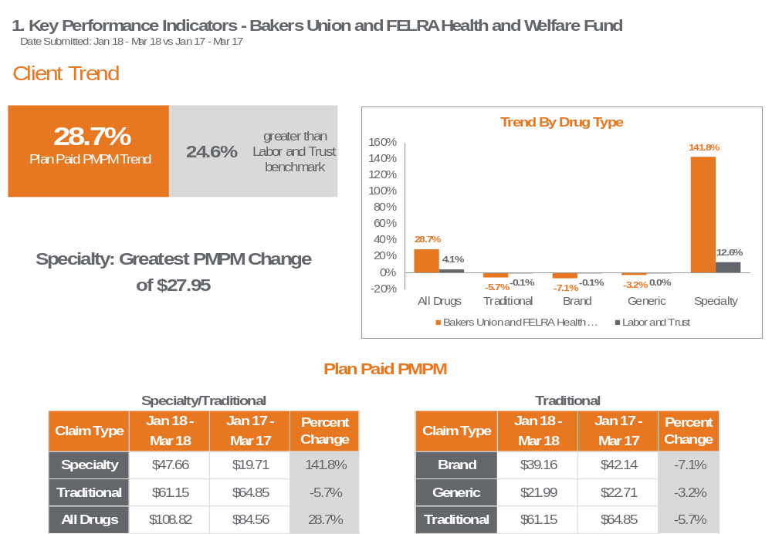

Slide 6
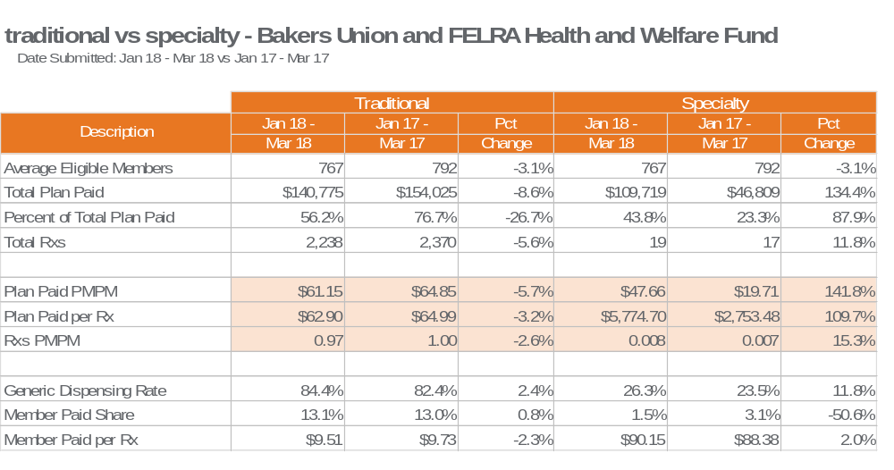

Slide 7
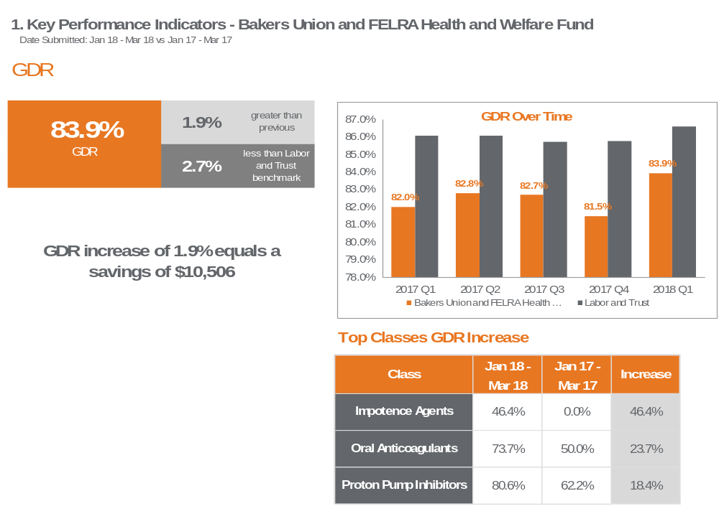

Slide 8
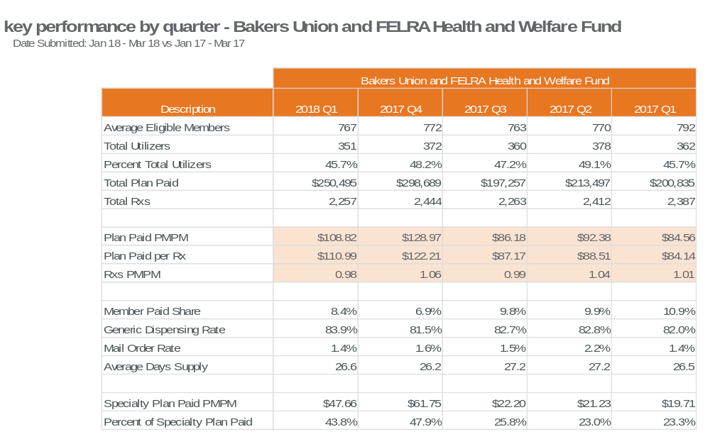

Slide 9
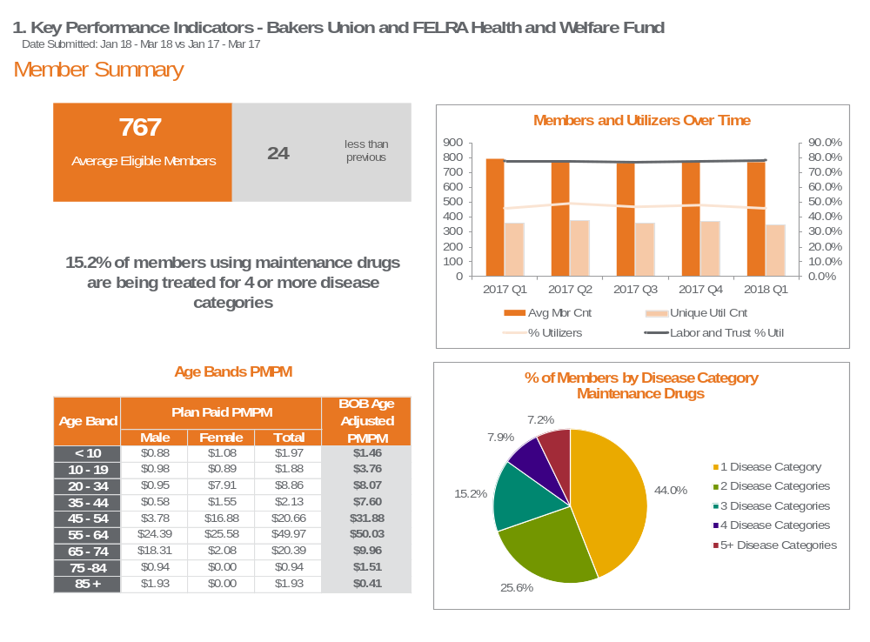

Slide 10
3. Three Period Trend

Slide 11
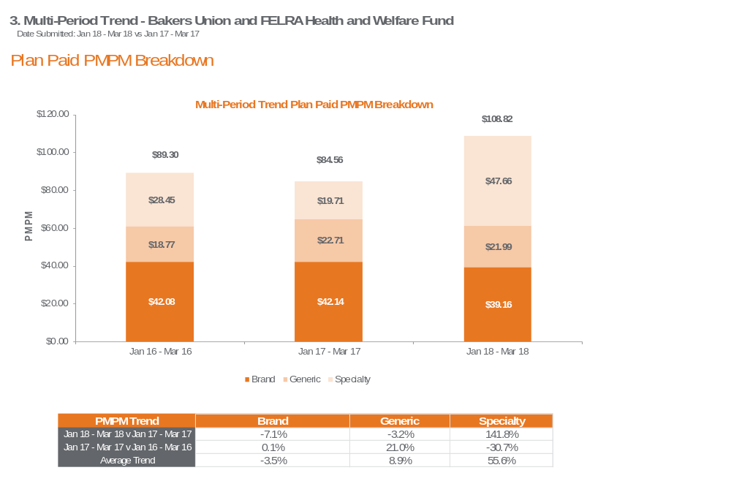

Slide 12
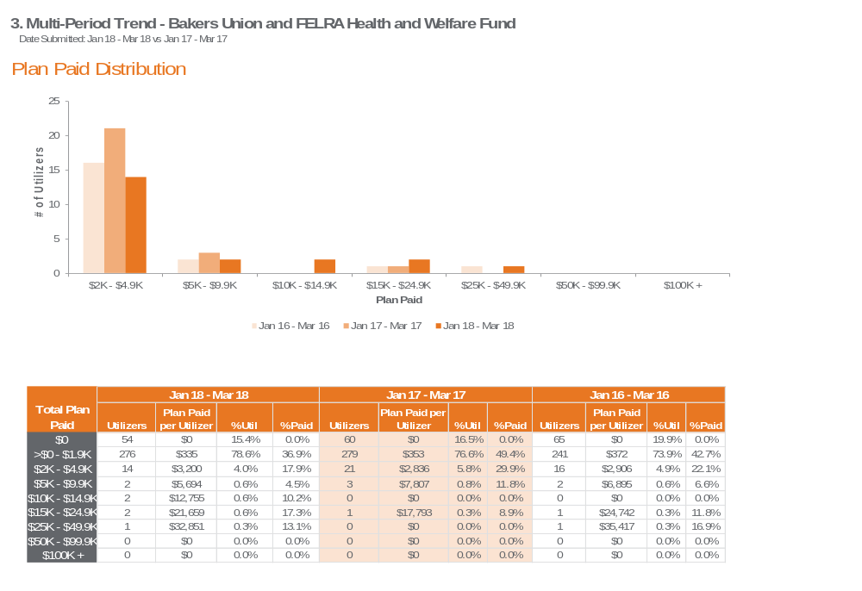

Slide 13
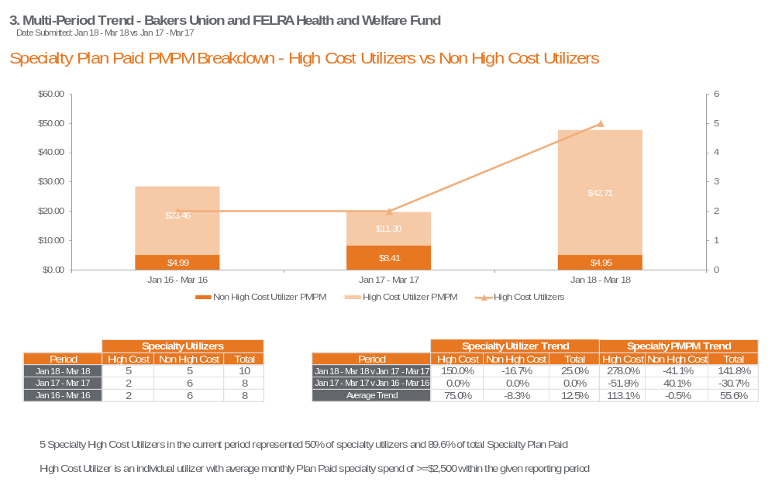

Slide 14
4. Cost Drivers

Slide 15
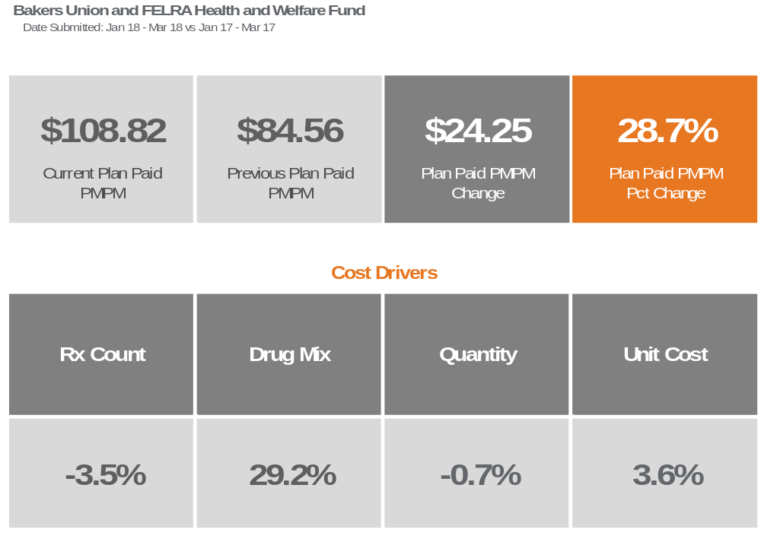

Slide 16
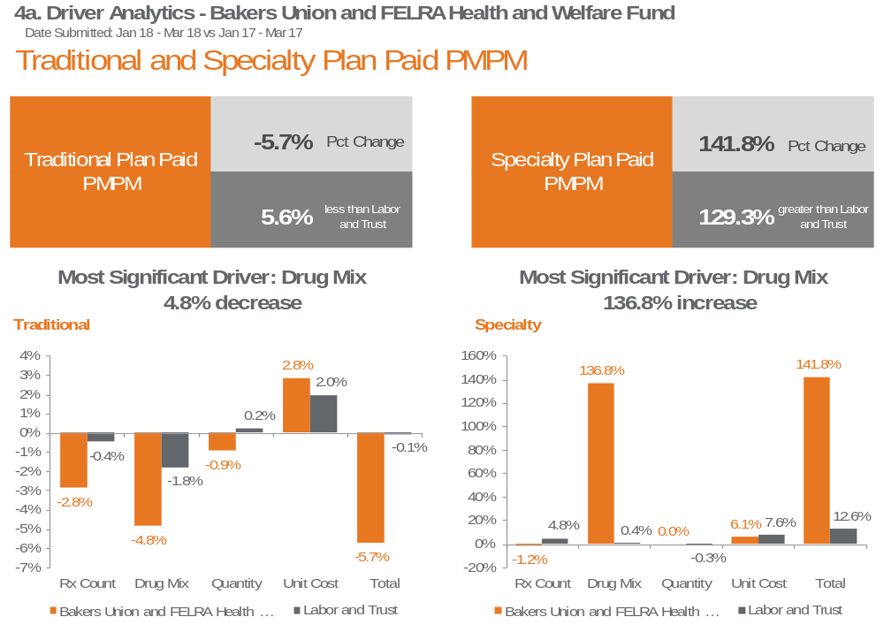

Slide 17
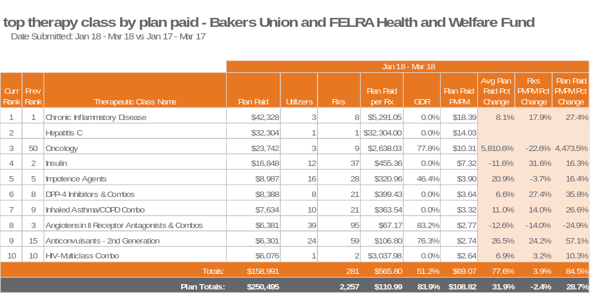

Slide 18
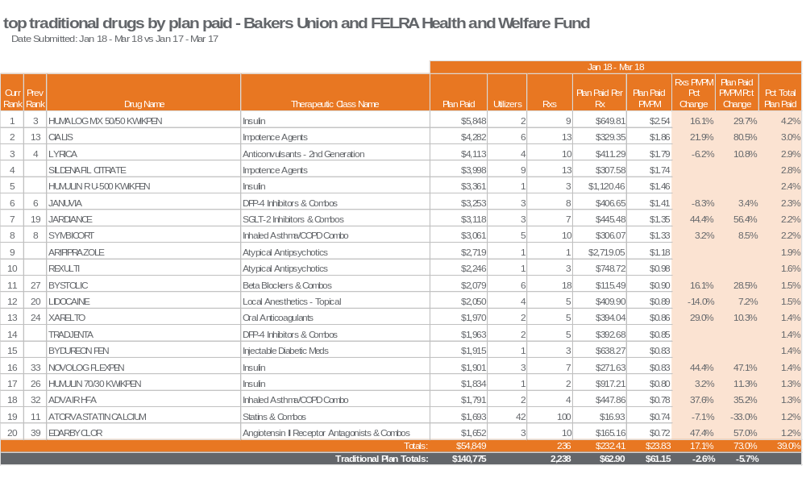
New meds not on previous ranking

Slide 19
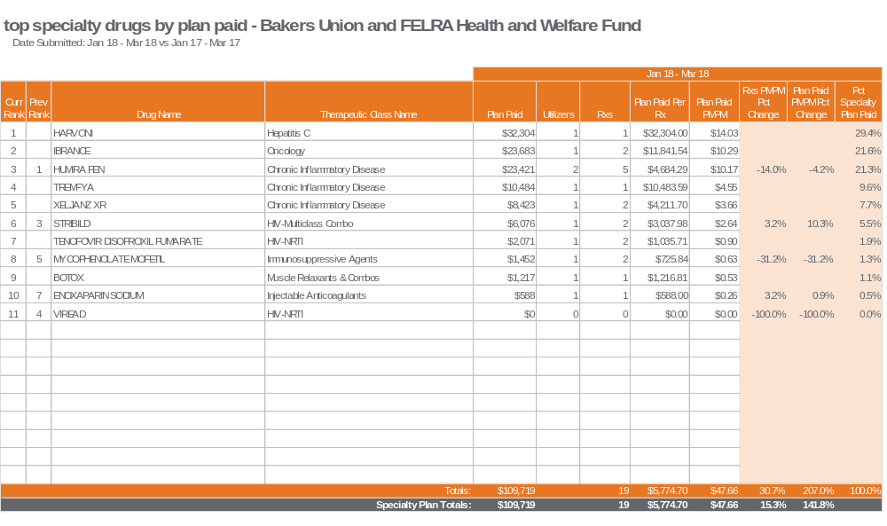
New meds not on previous ranking

Slide 20
5. Supplemental

Slide 21
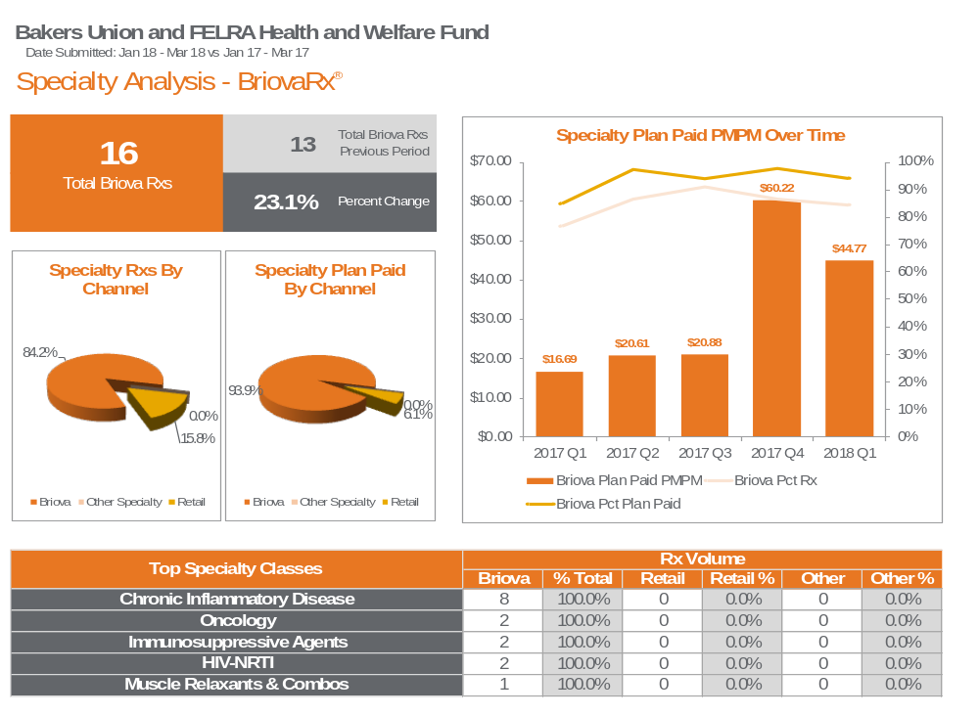

Slide 22
